Slide 1
COLLINS MUCYO
BOOK SEARCH APPLICATION

Slide 2
GOALS AND REQUIREMENTS
Use Google Books API
Enable user to search for a book title
View a list of all books searched
Click on a book to see more (Redirect to a browser)

Slide 3
Schedule
About Three weeks of:
Planning and design
Creating a back end with ASP .Net
Creating front end
Improving design

Slide 4
Difficulties Encountered
Google Books API authentication
Nativescript Redirecting
General UX design in Nativescript
Several app crashes

Slide 5
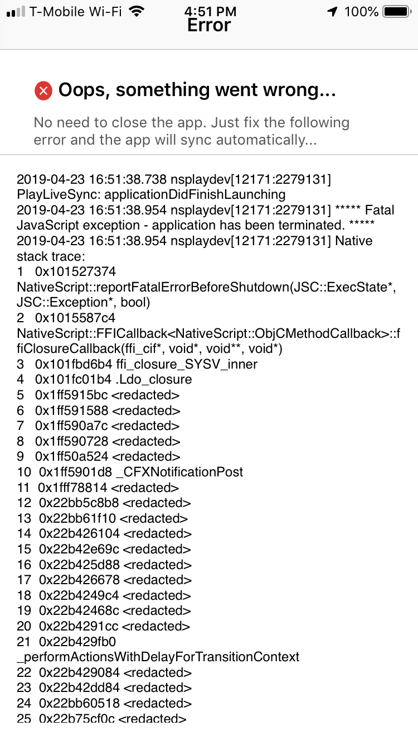
App Crashes

Slide 6
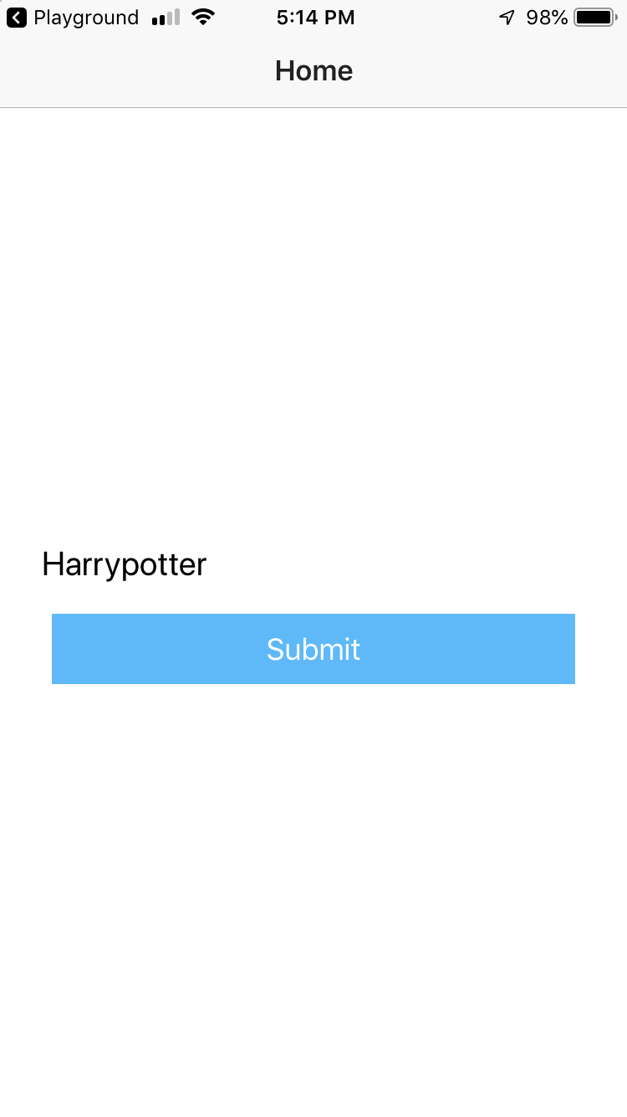
To Search

Slide 7
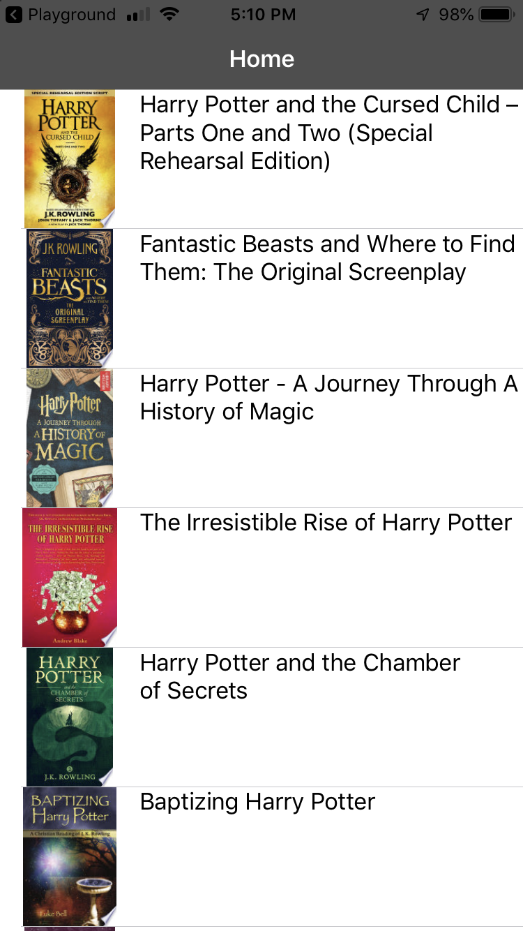
Results

Slide 8
Further Improvements
Improve App design
Highlighting cells
Improve functionality
Opening “See More” with book details
Improve and reconnect the back-end

